Slide 1


Slide 4
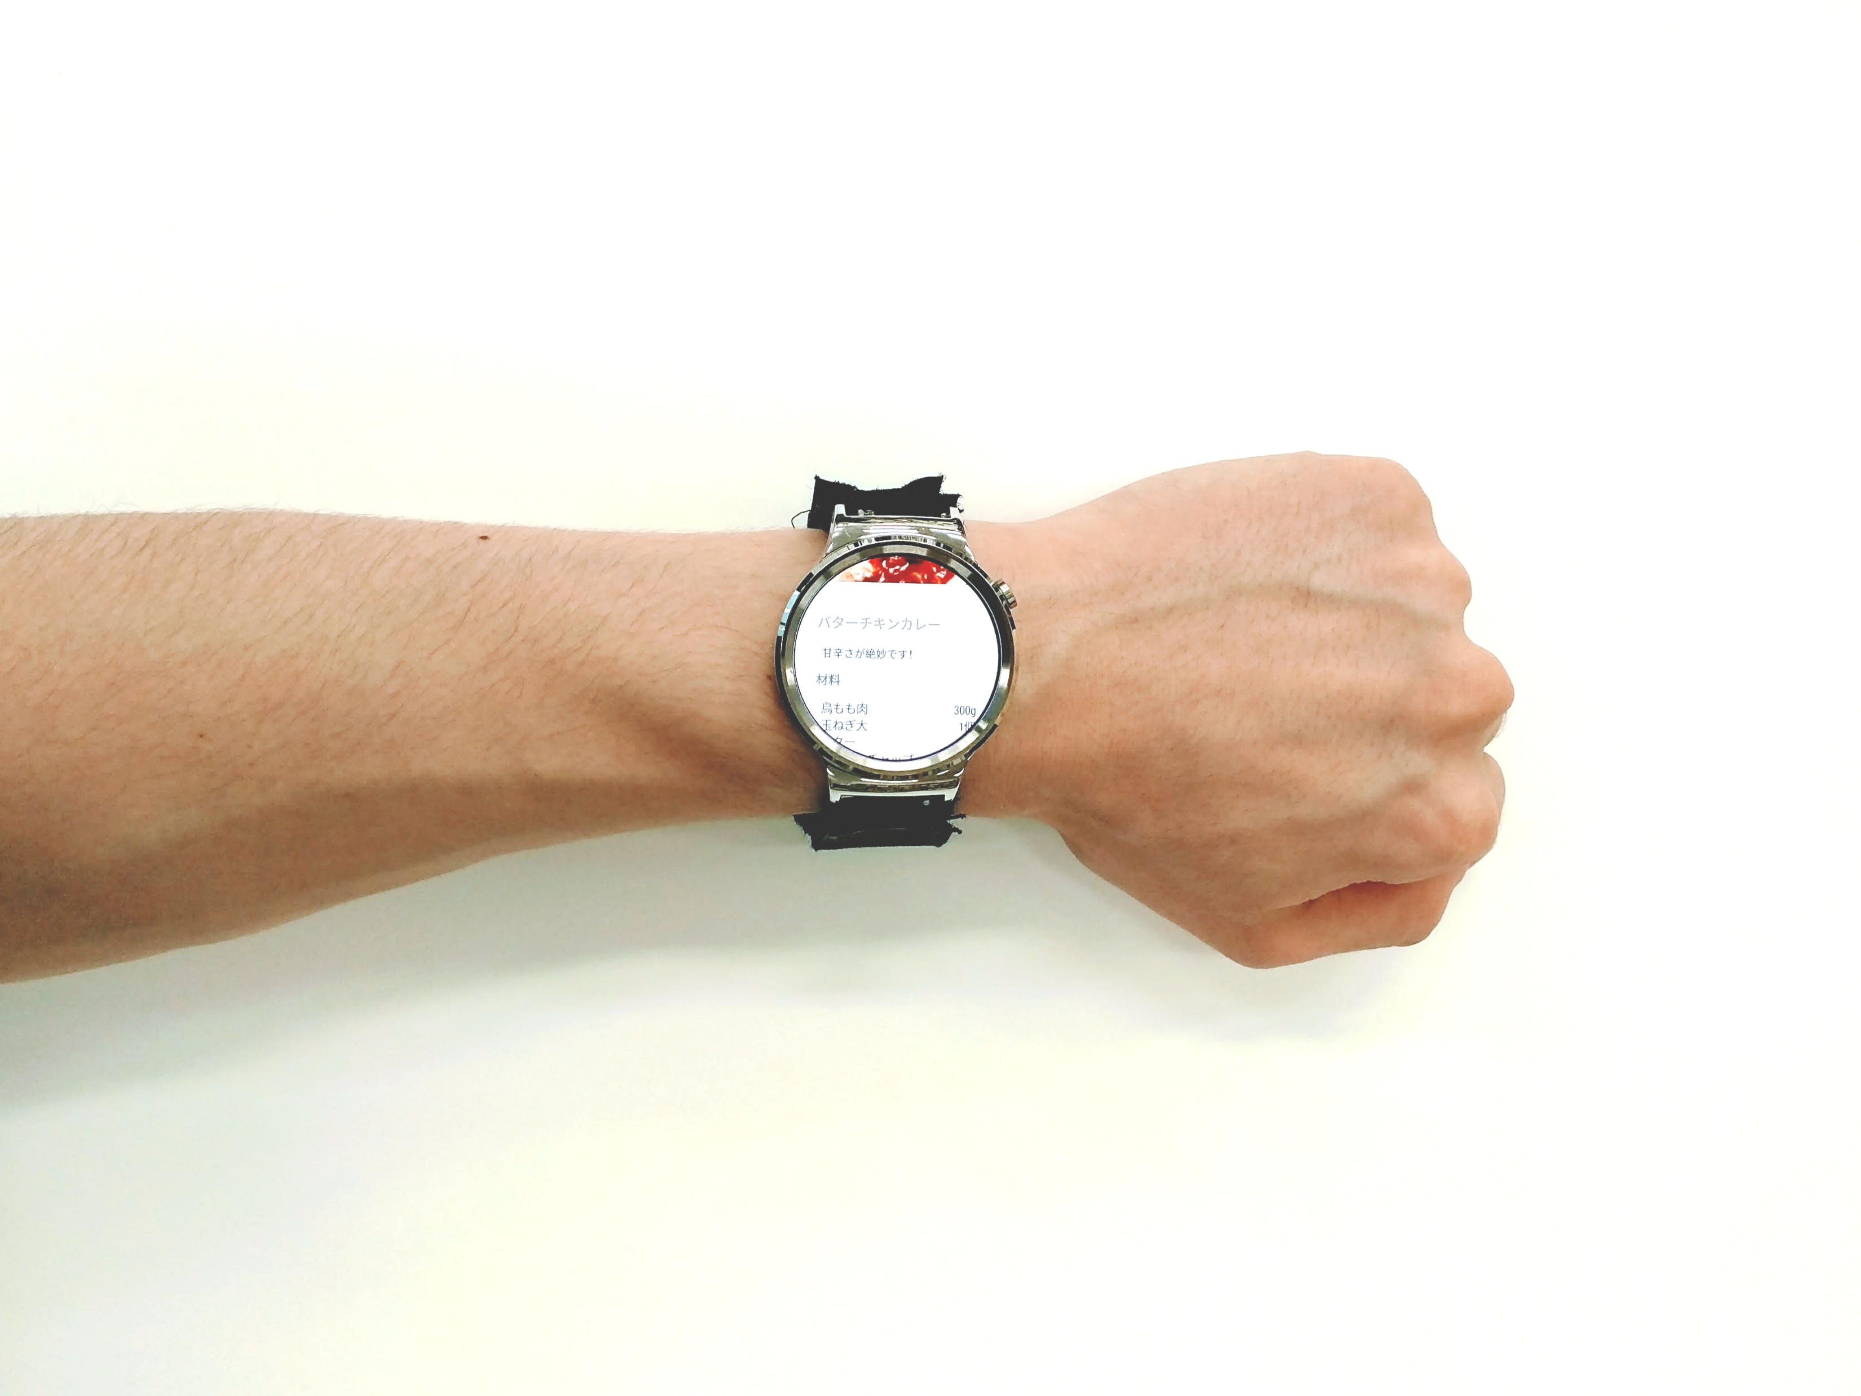

Slide 5
1
10
3
8
5
W
A
6
7
4
9
2
11

Slide 6
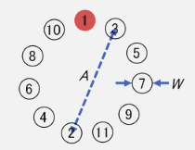

Slide 7
手法A
手法B

Slide 8
size(600, 600);
ellipse(width/2, height/2, width, height);
beginShape();
for (int i = 0; i < 11; i++) {
vertex(width/2 + width/2 * cos(radians(i * 360/11.0)),
height/2 + height/2 * sin(radians(i * 360/11.0)));
}
endShape(CLOSE);
for (int i = 0; i < 11; i++) {
line(width/2 + width/2 * cos(radians(i * 360/11.0)),
height/2 + height/2 * sin(radians(i * 360/11.0)), width/2, height/2);
}
ellipse(width/2, height/2, 5, 5);

Slide 9
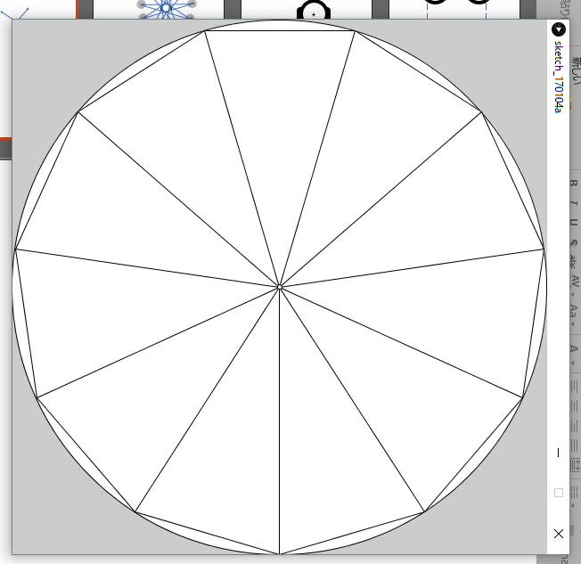
方向
5
7
3
9
1
11
10
2
8
4
6

Slide 10
方向
3
4
2
5
1
6
11
7
10
8
9

Slide 11

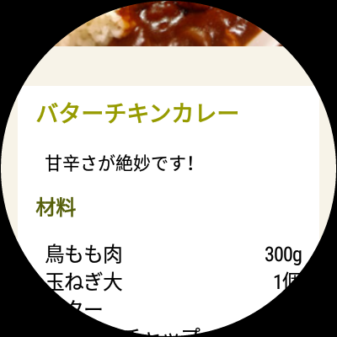
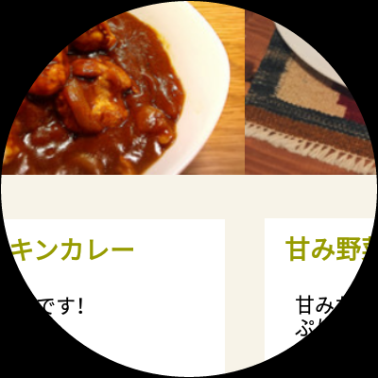

Slide 12


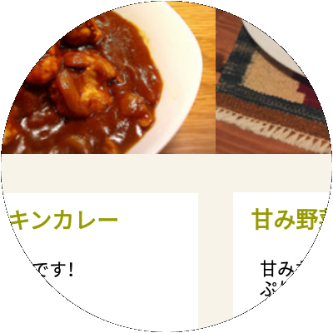
a
b
c

Slide 13
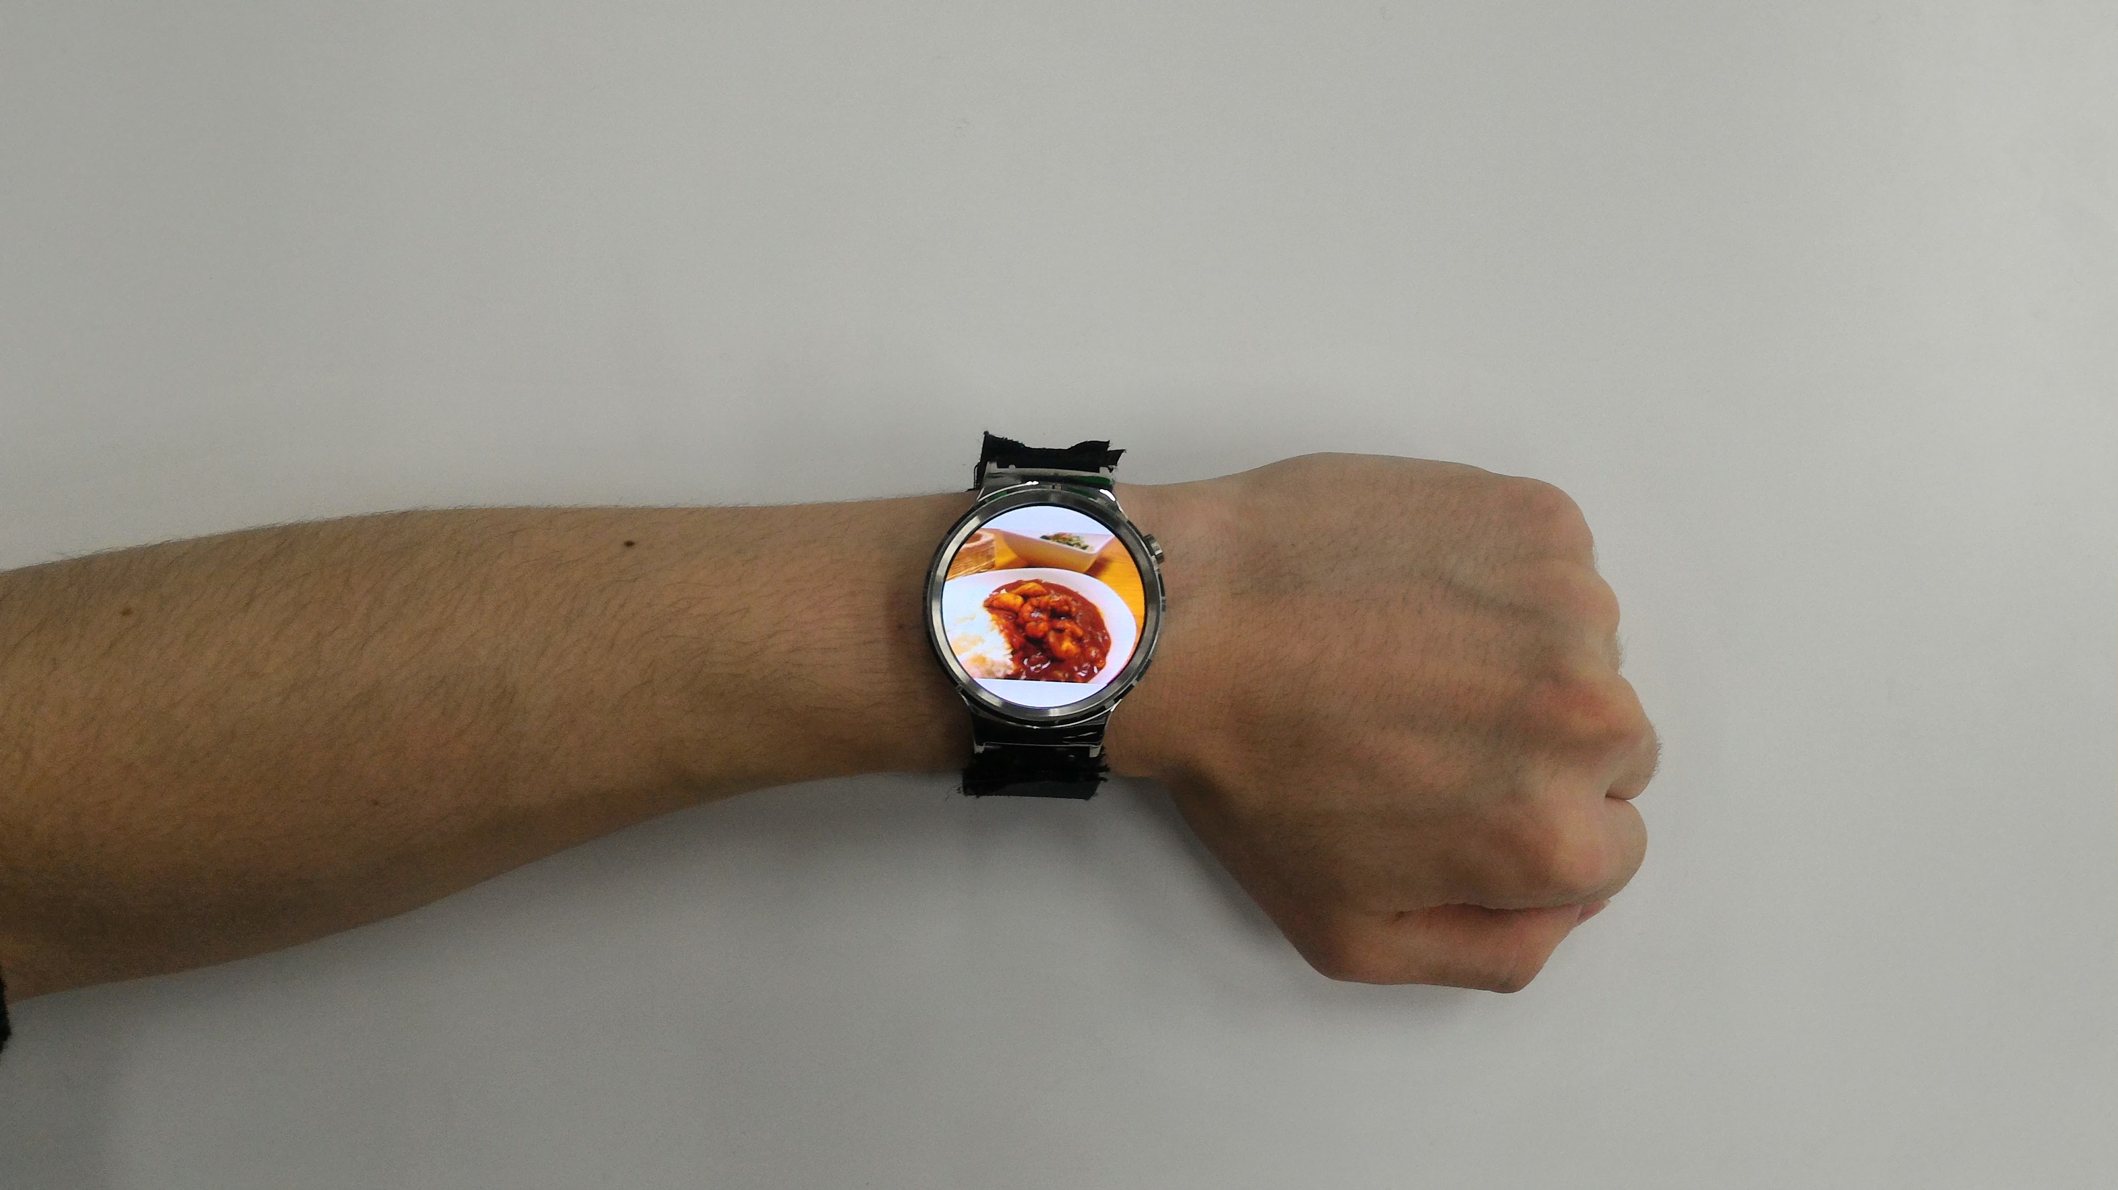
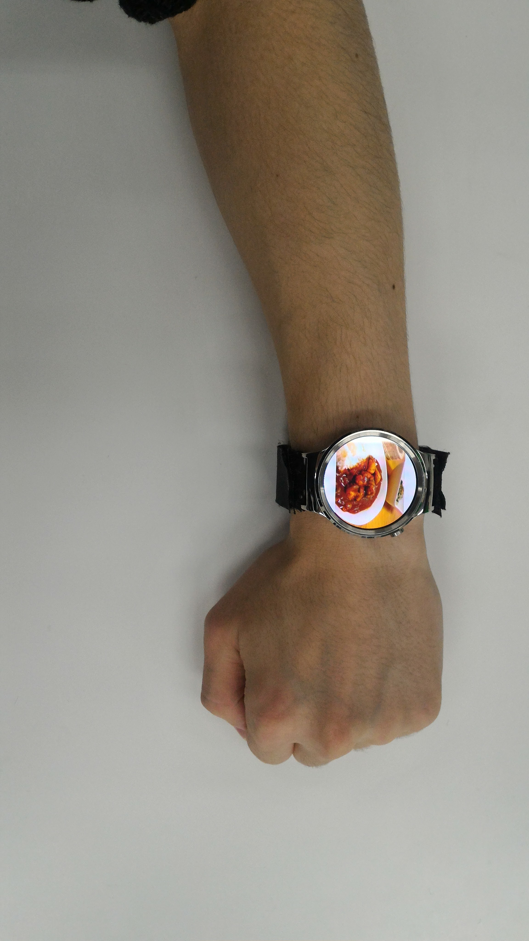
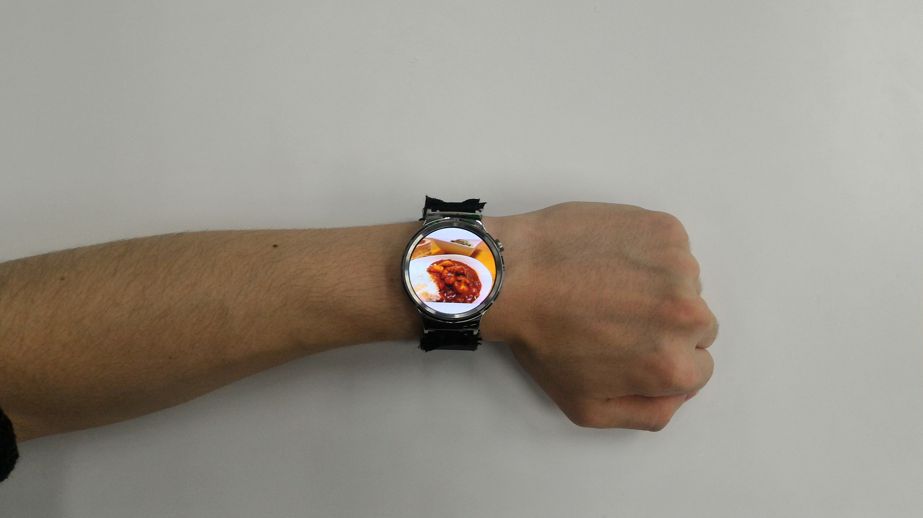
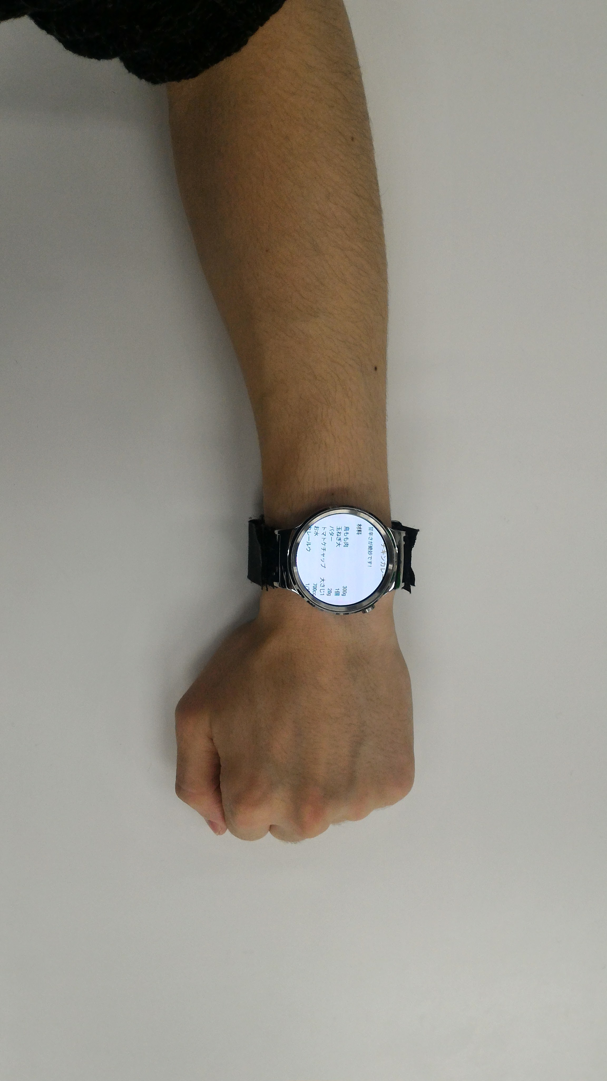
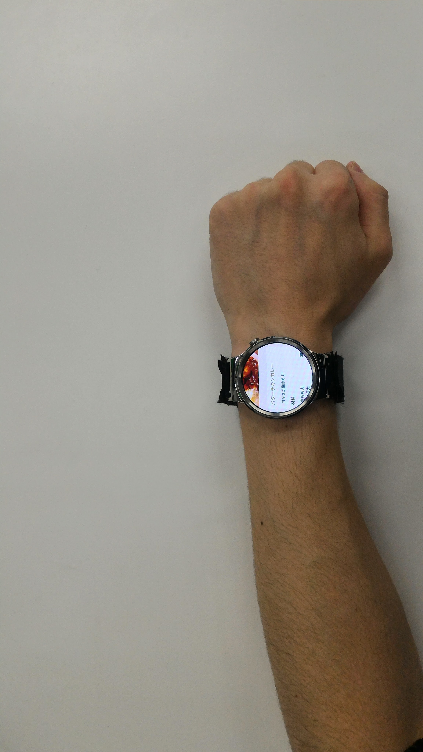
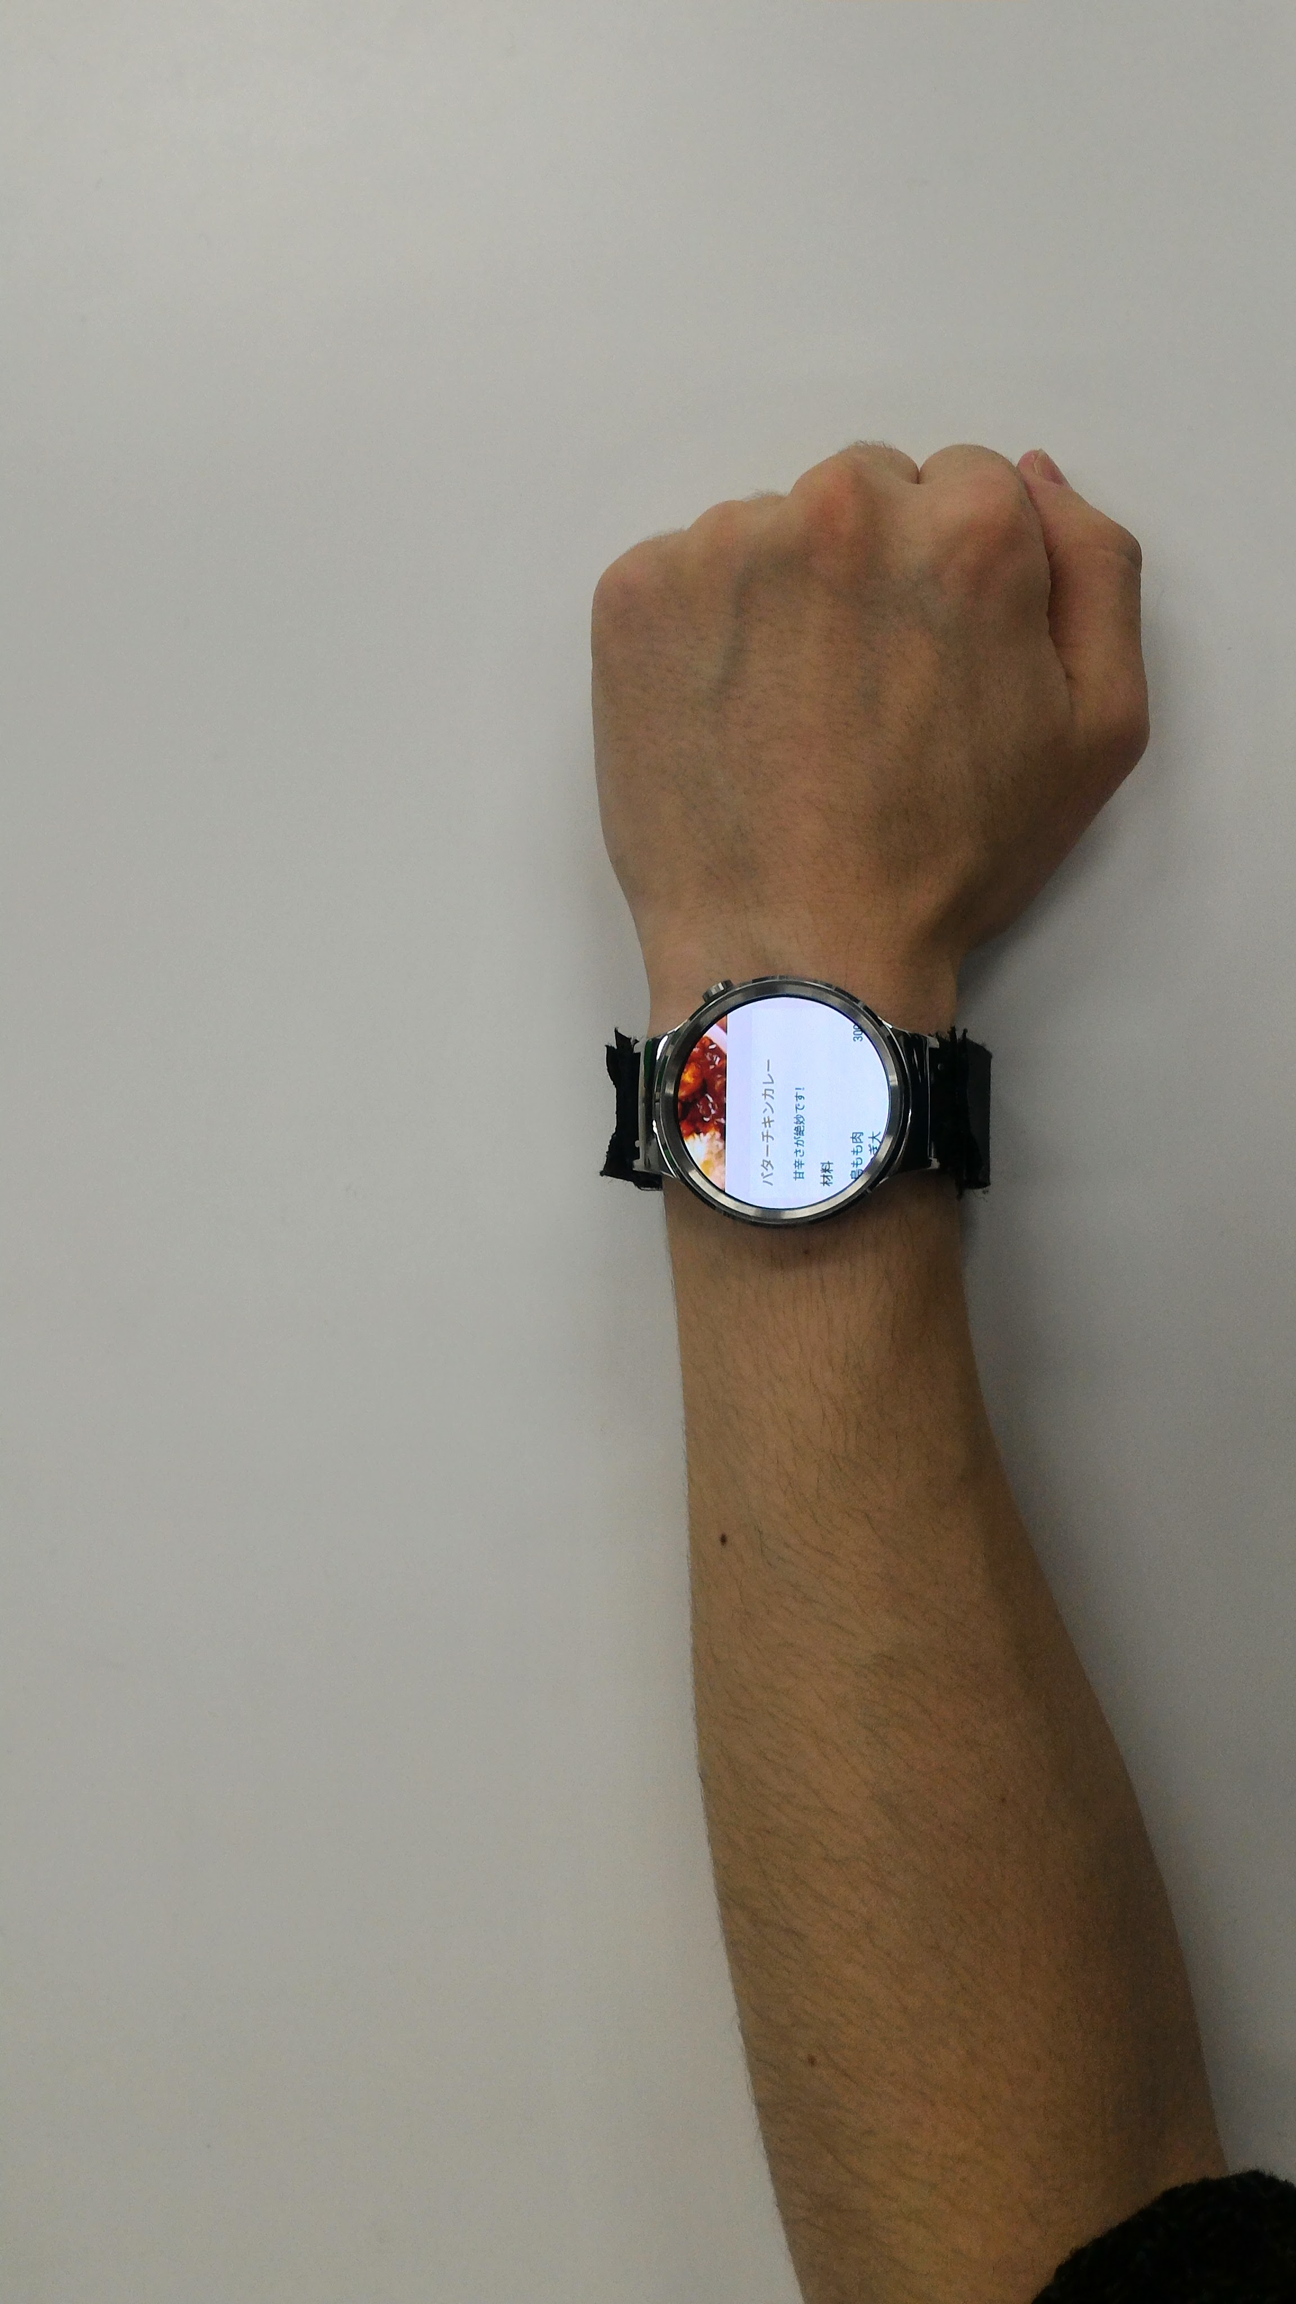
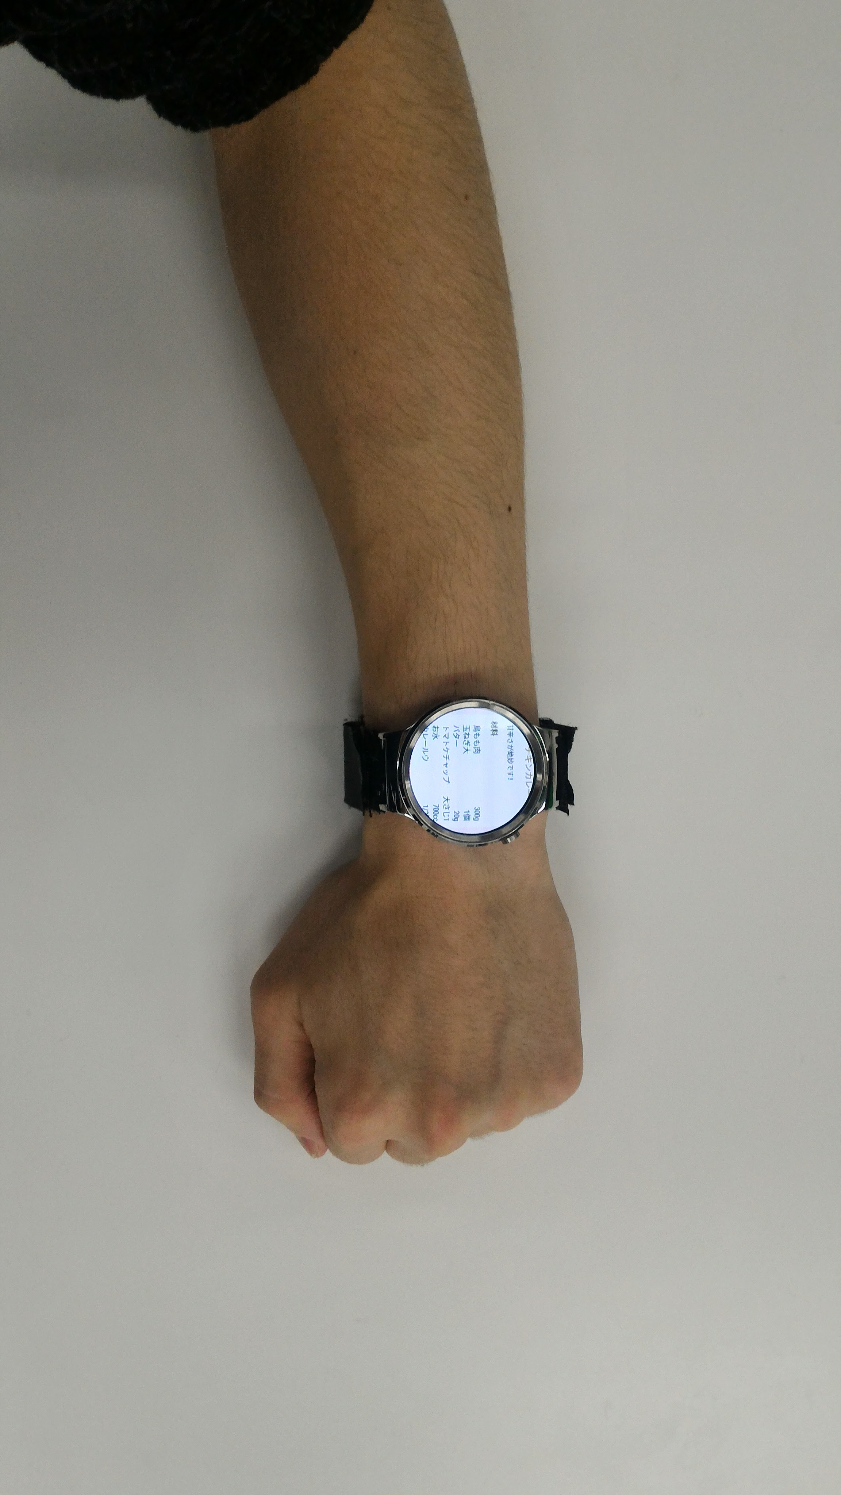
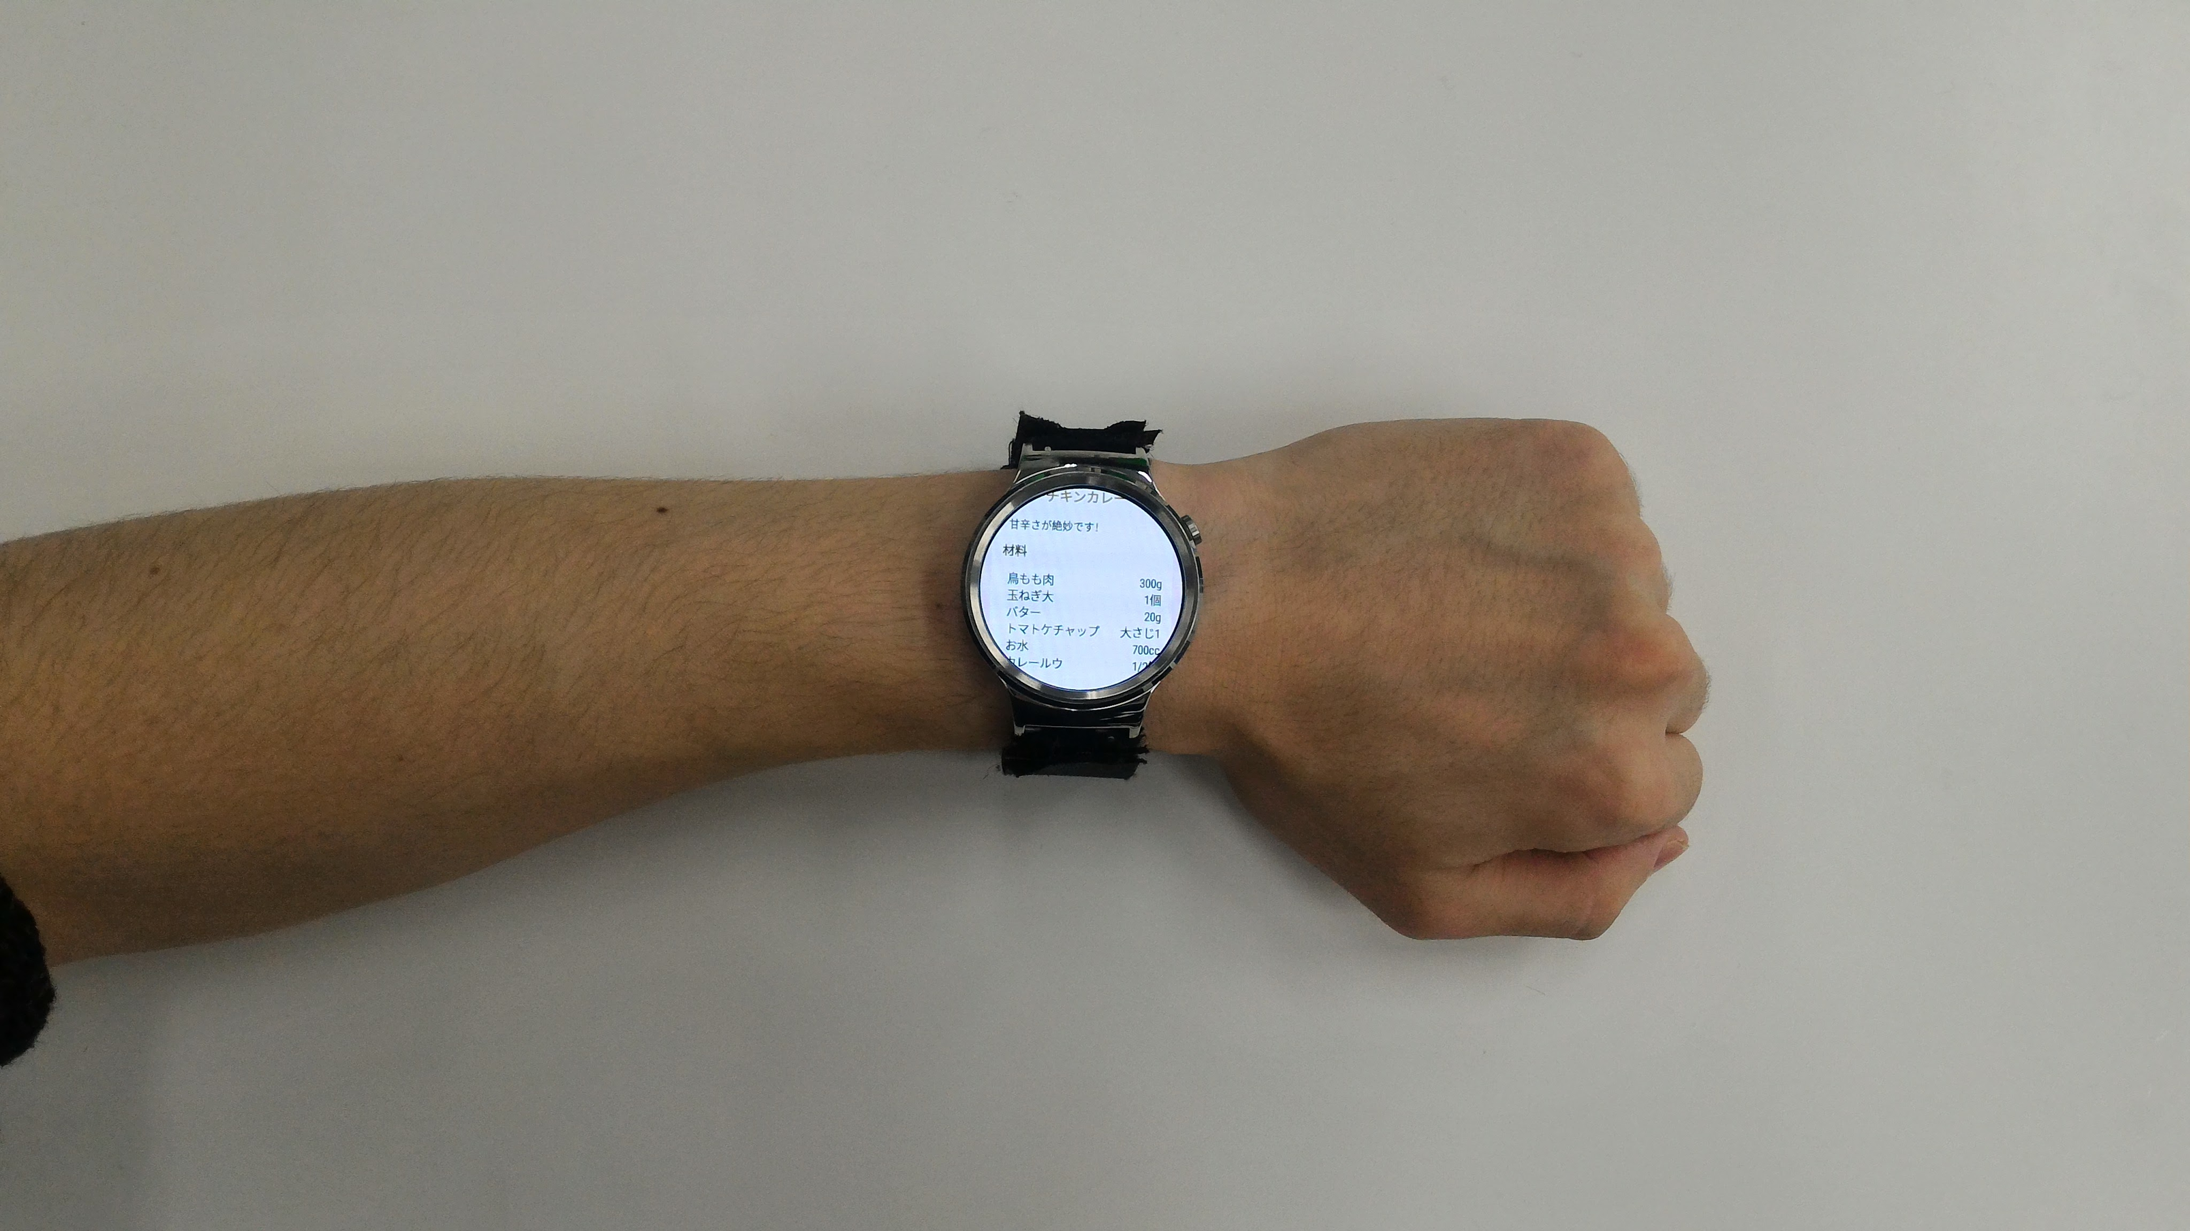

Slide 14
